Slide 1

Customer Sentiment & Service Experience Analysis
An end-to-end Python data analytics project that applies Pandas and NumPy for data preprocessing, grouping, and statistical summarization, and Matplotlib for advanced visual analytics. The analysis investigates customer sentiment patterns, rating–sentiment alignment, response time impact, complaint behavior, and service risk indicators to support data-driven customer support optimization.
SUPRATIM MAITY

Slide 2
Project Objective
The primary objective of this project is to perform an end-to-end customer sentiment and service experience analysis using Python.
The project aims to:
Analyze the overall distribution of customer sentiment (positive, neutral, negative).
Understand how customer ratings align with expressed sentiment.
Evaluate the impact of response time on customer sentiment.
Study how complaint registration and issue resolution influence customer satisfaction.
Identify silent dissatisfied customers who did not raise complaints despite negative sentiment.
Compare customer sentiment across platforms, product categories, regions, age groups, and gender.
Create a service risk score to quantify operational risk based on response delays, unresolved issues, and complaints.
Build a visual dashboard to connect sentiment, ratings, response time, complaints, and issue resolution in a single view.
Derive actionable business insights to improve customer support performance and service quality.

Slide 3

Problem Statements
This project attempts to answer the following business and analytical questions:
What is the overall sentiment distribution of customers?
Do customer ratings always match their sentiment, or are there misalignments?
How does response time affect customer sentiment and satisfaction?
Which response-time thresholds lead to higher negative sentiment?
Are customers with unresolved issues more likely to express negative sentiment?
6. How does complaint registration vary across sentiment categories?
7. Are there negatively dissatisfied customers who do not file complaints?
8. Which platforms and product categories show higher service risk?
9. How does customer sentiment differ across demographics (age group, gender)?
10. Which regions have higher average response time and lower customer ratings?
11. How can customer service risk be quantified numerically for better decision-making?

Slide 4

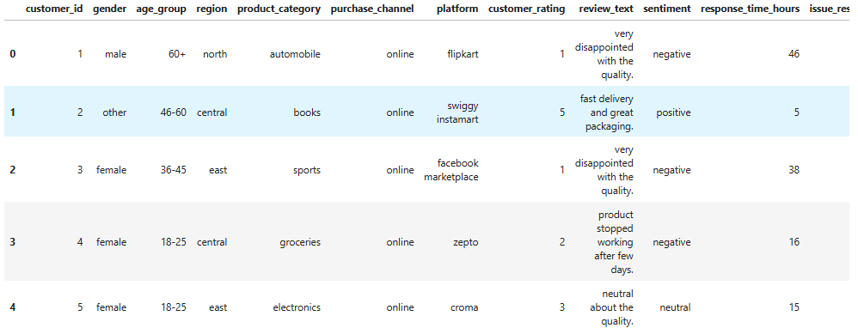
Analytical Approach & Solutions
1. Import Libraries
import pandas as pd
import numpy as np
import matplotlib.pyplot as plt
2. Load Dataset
# Importing the dataset
df = pd.read_csv("C:\\Users\\supra\\Desktop\\Python_project\\Customer_Sentiment\\Customer_Sentiment.csv")
# To see the total rows and columns
df.shape
OUTPUT →
# To see my loaded data
df.head()
OUTPUT →

Slide 5
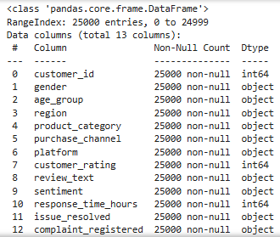
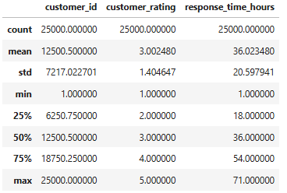
OUTPUT →
# Quick summary of the Dataframe
df.info()
# Statistical summary of Dataframe
df.describe()
OUTPUT →

Slide 6

3. Data Cleaning & Standardization
# Define all categorical (text) columns to apply uniform cleaning operations
text_cols = [
'gender','region','product_category','platform',
'purchase_channel','sentiment',
'issue_resolved','complaint_registered’]
# Handle missing text values
df[text_cols] = df[text_cols].fillna('unknown’)
# Standardize text
for col in text_cols:
df[col] = df[col].str.lower().str.strip()
# Normalize binary columns
df['issue_resolved'] = df['issue_resolved'].replace({
'yes': 'yes', 'y': 'yes', 'true': 'yes',
'no': 'no', 'n': 'no', 'false': 'no'
})
df['complaint_registered'] = df['complaint_registered'].replace({
'yes': 'yes', 'y': 'yes',
'no': 'no', 'n': 'no'
})
# Remove duplicates
df.drop_duplicates(inplace=True)

Slide 7
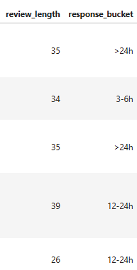
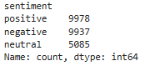
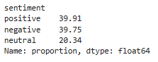
4. Creating New Columns
#To see how long customer reviews are and how fast support replies.
df['review_length'] = df['review_text'].str.len()
df['response_bucket'] = pd.cut(
df['response_time_hours'],
bins=[0,1,3,6,12,24,100],
labels=['<1h','1-3h','3-6h','6-12h','12-24h','>24h']
)
df
OUTPUT →
5. Overall Sentiment Distribution
#To understand how many customers fall into each sentiment category
OUTPUT →
df['sentiment'].value_counts()
6. Sentiment Percentage Contribution
#To find the percentage distribution of customer sentiments
sentiment_percentage = (
df['sentiment']
.value_counts(normalize=True)
.mul(100)
.round(2)
)
sentiment_percentage
OUTPUT →

Slide 8
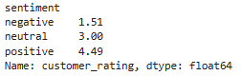
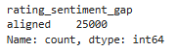
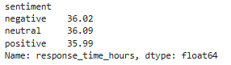
7. Sentiment vs Customer Rating
#To understand the average customer rating for each sentiment type.
avg_rating_by_sentiment = (
df.groupby('sentiment')['customer_rating']
.mean()
.round(2)
)
avg_rating_by_sentiment
OUTPUT →
8. Rating–Sentiment Misalignment
#To identify customers whose ratings and sentiments do not match each other.
df['rating_sentiment_gap'] = np.where(
(df['customer_rating'] >= 4) & (df['sentiment'] == 'negative'),
'high_rating_negative',
np.where(
(df['customer_rating'] <= 2) & (df['sentiment'] == 'positive'),
'low_rating_positive',
'aligned'))
df['rating_sentiment_gap'].value_counts()
OUTPUT →
9. Response Time Analysis
#To understand the average response time for each customer sentiment.
avg_response_time = (
df.groupby('sentiment')['response_time_hours']
.mean()
.round(2)
)
avg_response_time
OUTPUT →

Slide 9
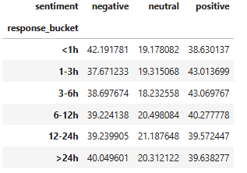
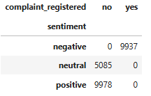
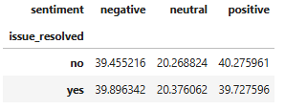
Response Time Threshold Analysis
#To understand how customer sentiment is distributed across different response-time categories.
pd.crosstab(
df['response_bucket'],
df['sentiment'],
normalize='index'
) * 100
OUTPUT →
10. Complaint Analysis
#To understand how complaint registration varies across different customer sentiments.
complaint_sentiment = pd.crosstab(
df['sentiment'],
df['complaint_registered']
)
complaint_sentiment
OUTPUT →
11. Issue Resolution Impact on Sentiment
#To understand the percentage distribution of customer sentiment for resolved and unresolved issues.
resolution_sentiment=pd.crosstab(
df['issue_resolved'],
df['sentiment'],
normalize='index'
) * 100
resolution_sentiment
OUTPUT →

Slide 10
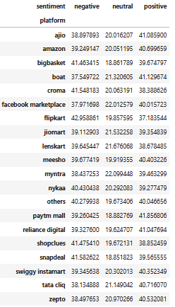
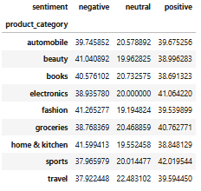
12. Platform Performance
#To understand how customer sentiment varies across different platforms.
pd.crosstab(
df['platform'],
df['sentiment'],
normalize='index'
) * 100
OUTPUT →
13. Product Category Performance
#To understand how customer sentiment differs across product categories.
pd.crosstab(
df['product_category'],
df['sentiment'],
normalize='index'
) * 100
OUTPUT →

Slide 11
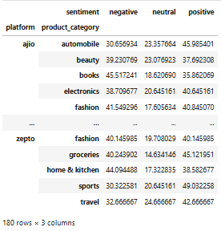
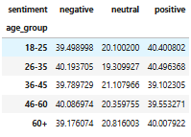
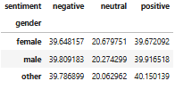
14. Platform × Product × Sentiment
#To understand how customer sentiment varies across different platform and product category combinations.
Comparison=pd.crosstab(
[df['platform'], df['product_category']],
df['sentiment'],
normalize='index'
) * 100
Comparison
OUTPUT →
15. Demographic Analysis
#To understand how customer sentiment varies across different age groups.
OUTPUT →
pd.crosstab(df['age_group'], df['sentiment'], normalize='index') * 100
#To understand how customer sentiment differs between genders.
OUTPUT →
pd.crosstab(df['gender'], df['sentiment'], normalize='index') * 100

Slide 12
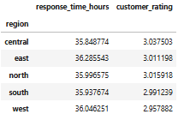

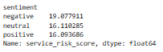
16. Regional Performance
#To understand average response time and customer rating across different regions.
OUTPUT →
df.groupby('region')[['response_time_hours','customer_rating']].mean()
17. Silent Dissatisfaction
#To find the percentage of negatively dissatisfied customers who did not register a complaint.
silent_negative = df[
(df['sentiment']=='negative') &
(df['complaint_registered']=='no')
]
silent_negative.shape[0] / df[df['sentiment']=='negative'].shape[0] * 100
OUTPUT →
18. Custom Service Risk Score
#To calculate a service risk score and understand how service risk differs across customer sentiments.
df['service_risk_score'] = (
df['response_time_hours'] * 0.4 +
(df['issue_resolved']=='no') * 5 +
(df['complaint_registered']=='yes') * 3
)
df.groupby('sentiment')['service_risk_score'].mean()
OUTPUT →

Slide 13
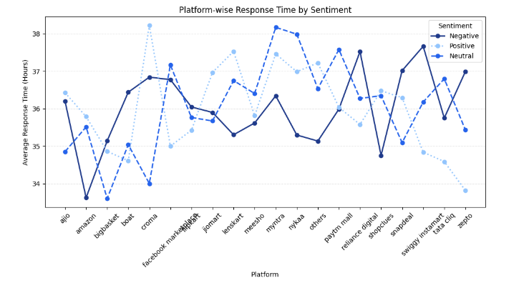
19. Multi-Line Visualization: Platform vs Response Time by Sentiment
# To compare average response time across platforms for different customer sentiments
plt.figure(figsize=(10, 6))
# Color variants for sentiments
sentiment_styles = {
'negative': {'color': '#1f3a8a', 'linestyle': '-', 'marker': 'o'},
'neutral': {'color': '#2563eb', 'linestyle': '--', 'marker': 'o'},
'positive': {'color': '#93c5fd', 'linestyle': ':', 'marker': 'o'}
}
for sentiment in df['sentiment'].unique():
temp = df[df['sentiment'] == sentiment]
avg = temp.groupby('platform')['response_time_hours'].mean()
plt.plot(
avg.index,
avg.values,
label=sentiment.capitalize(),
color=sentiment_styles[sentiment]['color'],
linestyle=sentiment_styles[sentiment]['linestyle'],
marker=sentiment_styles[sentiment]['marker'],
linewidth=2
)
plt.title("Platform-wise Response Time by Sentiment")
plt.xlabel("Platform")
plt.ylabel("Average Response Time (Hours)")
plt.xticks(rotation=45)
plt.grid(axis='y', linestyle='--', alpha=0.3)
plt.legend(title="Sentiment")
plt.tight_layout()
plt.show()
OUTPUT →

Slide 14
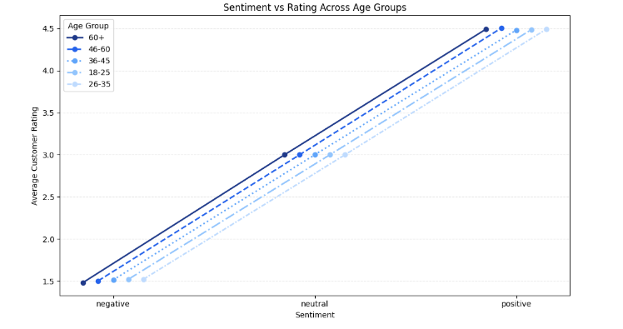
20. Multi-Line Visualization: Age Group Sensitivity
#To understand how customer ratings vary across sentiments for different age groups.
plt.figure(figsize=(10, 6))
sentiments = ['negative', 'neutral', 'positive']
x = np.arange(len(sentiments))
offsets = np.linspace(-0.15, 0.15, df['age_group'].nunique())
blue_palette = [
"#1f3a8a",
"#2563eb",
"#60a5fa",
"#93c5fd",
"#bfdbfe"
]
line_styles = ['-', '--', ':', '-.', (0, (3, 1, 1, 1))]
for i, (offset, age) in enumerate(zip(offsets, df['age_group'].unique())):
age_data = df[df['age_group'] == age]
avg_rating = age_data.groupby('sentiment')['customer_rating'].mean()
plt.plot(
x + offset,
avg_rating.loc[sentiments],
marker='o',
label=age,
color=blue_palette[i % len(blue_palette)],
linestyle=line_styles[i % len(line_styles)],
linewidth=2
)
plt.xticks(x, sentiments)
plt.title("Sentiment vs Rating Across Age Groups")
plt.xlabel("Sentiment")
plt.ylabel("Average Customer Rating")
plt.grid(axis='y', linestyle='--', alpha=0.3)
plt.legend(title="Age Group")
plt.tight_layout()
plt.show()
OUTPUT →

Slide 15
DASHBOARD
# Dashboard to understand how customer ratings vary across sentiments for different age groups
# =========================
# Customer Sentiment & Service Experience Dashboard
# To understand how customer sentiment, ratings, response time,
# complaints, and issue resolution are connected.
# =========================
import pandas as pd
import matplotlib.pyplot as plt
# =========================
# Colors
# =========================
DARK_BLUE = "#1f3a8a"
PRIMARY_BLUE = "#2563eb"
SKY_BLUE = "#60a5fa"
LIGHT_BLUE = "#93c5fd“
# =========================
# Function to add labels on bars
# =========================
def add_bar_labels(ax, total=None, show_percent=False):
for container in ax.containers:
for bar in container:
height = bar.get_height()
if height == 0:
continue
if show_percent and total is not None:
label = f"{int(height)}\n({height/total*100:.1f}%)"
else:
label = f"{height:.2f}" if height < 10 else f"{int(height)}"
ax.annotate(
label,
(bar.get_x() + bar.get_width() / 2, height),
ha='center',
va='bottom',
fontsize=9,
xytext=(0, 3),
textcoords='offset points'
)
# =========================
# Create figure and axes
# =========================
fig, axes = plt.subplots(2, 3, figsize=(18, 10))
fig.suptitle(
"Customer Sentiment & Service Experience Dashboard",
fontsize=16,
fontweight='bold'
)
# =========================
# Plot 1: Sentiment Distribution
# =========================
sentiment_counts = df['sentiment'].value_counts()
total_sentiments = sentiment_counts.sum()
axes[0, 0].bar(
sentiment_counts.index,
sentiment_counts.values,
color=PRIMARY_BLUE
)
axes[0, 0].set_title("Sentiment Distribution")
axes[0, 0].set_xlabel("Sentiment")
axes[0, 0].set_ylabel("Count")
add_bar_labels(axes[0, 0], total=total_sentiments)
# =========================
# Plot 2: Average Rating by Sentiment
# =========================
avg_rating = df.groupby('sentiment')['customer_rating'].mean()
axes[0, 1].barh(
avg_rating.index,
avg_rating.values,
color=SKY_BLUE
)
axes[0, 1].set_title("Average Rating by Sentiment")
axes[0, 1].set_xlabel("Rating")
axes[0, 1].set_ylabel("Sentiment")
for bar in axes[0, 1].containers[0]:
width = bar.get_width()
axes[0, 1].annotate(
f"{width:.2f}",
(width, bar.get_y() + bar.get_height() / 2),
va='center',
ha='left',
fontsize=9,
xytext=(4, 0),
textcoords='offset points'
)

Slide 16
# =========================
# Plot 3: Average Response Time by Sentiment
# =========================
avg_response = df.groupby('sentiment')['response_time_hours'].mean()
axes[0, 2].bar(
avg_response.index,
avg_response.values,
color=DARK_BLUE
)
axes[0, 2].set_title("Avg Response Time by Sentiment")
axes[0, 2].set_xlabel("Sentiment")
axes[0, 2].set_ylabel("Hours")
add_bar_labels(axes[0, 2])
# =========================
# Plot 4: Issue Resolution Share
# =========================
resolution_counts = df['issue_resolved'].value_counts()
axes[1, 0].pie(
resolution_counts.values,
labels=resolution_counts.index,
autopct='%1.1f%%',
startangle=90,
colors=[PRIMARY_BLUE, LIGHT_BLUE],
wedgeprops={'edgecolor': 'white'}
)
axes[1, 0].set_title("Issue Resolution Share")
# =========================
# Plot 5: Complaint vs Sentiment
# =========================
complaint_sentiment = pd.crosstab(
df['complaint_registered'],
df['sentiment']
)
complaint_sentiment.plot(
kind='bar',
stacked=True,
ax=axes[1, 1],
color=[PRIMARY_BLUE, SKY_BLUE, LIGHT_BLUE]
)
axes[1, 1].set_title("Complaint vs Sentiment")
axes[1, 1].set_xlabel("Complaint Registered")
axes[1, 1].set_ylabel("Count")
axes[1, 1].legend(title="Sentiment")
for container in axes[1, 1].containers:
axes[1, 1].bar_label(container, label_type='center', fontsize=8)
# =========================
# Plot 6: Platform-wise Avg Response Time
# =========================
platform_response = df.groupby('platform')['response_time_hours'].mean()
axes[1, 2].plot(
platform_response.values,
platform_response.index,
marker='o',
linewidth=2,
color=PRIMARY_BLUE
)
axes[1, 2].set_title("Platform-wise Avg Response Time")
axes[1, 2].set_xlabel("Hours")
axes[1, 2].set_ylabel("Platform")
axes[1, 2].grid(axis='x', linestyle='--', alpha=0.4)
# =========================
# Final Styling & Layout
# =========================
for ax in axes.flat:
ax.spines['top'].set_visible(False)
ax.spines['right'].set_visible(False)
plt.tight_layout(rect=[0, 0, 1, 0.95])
plt.show()

Slide 17

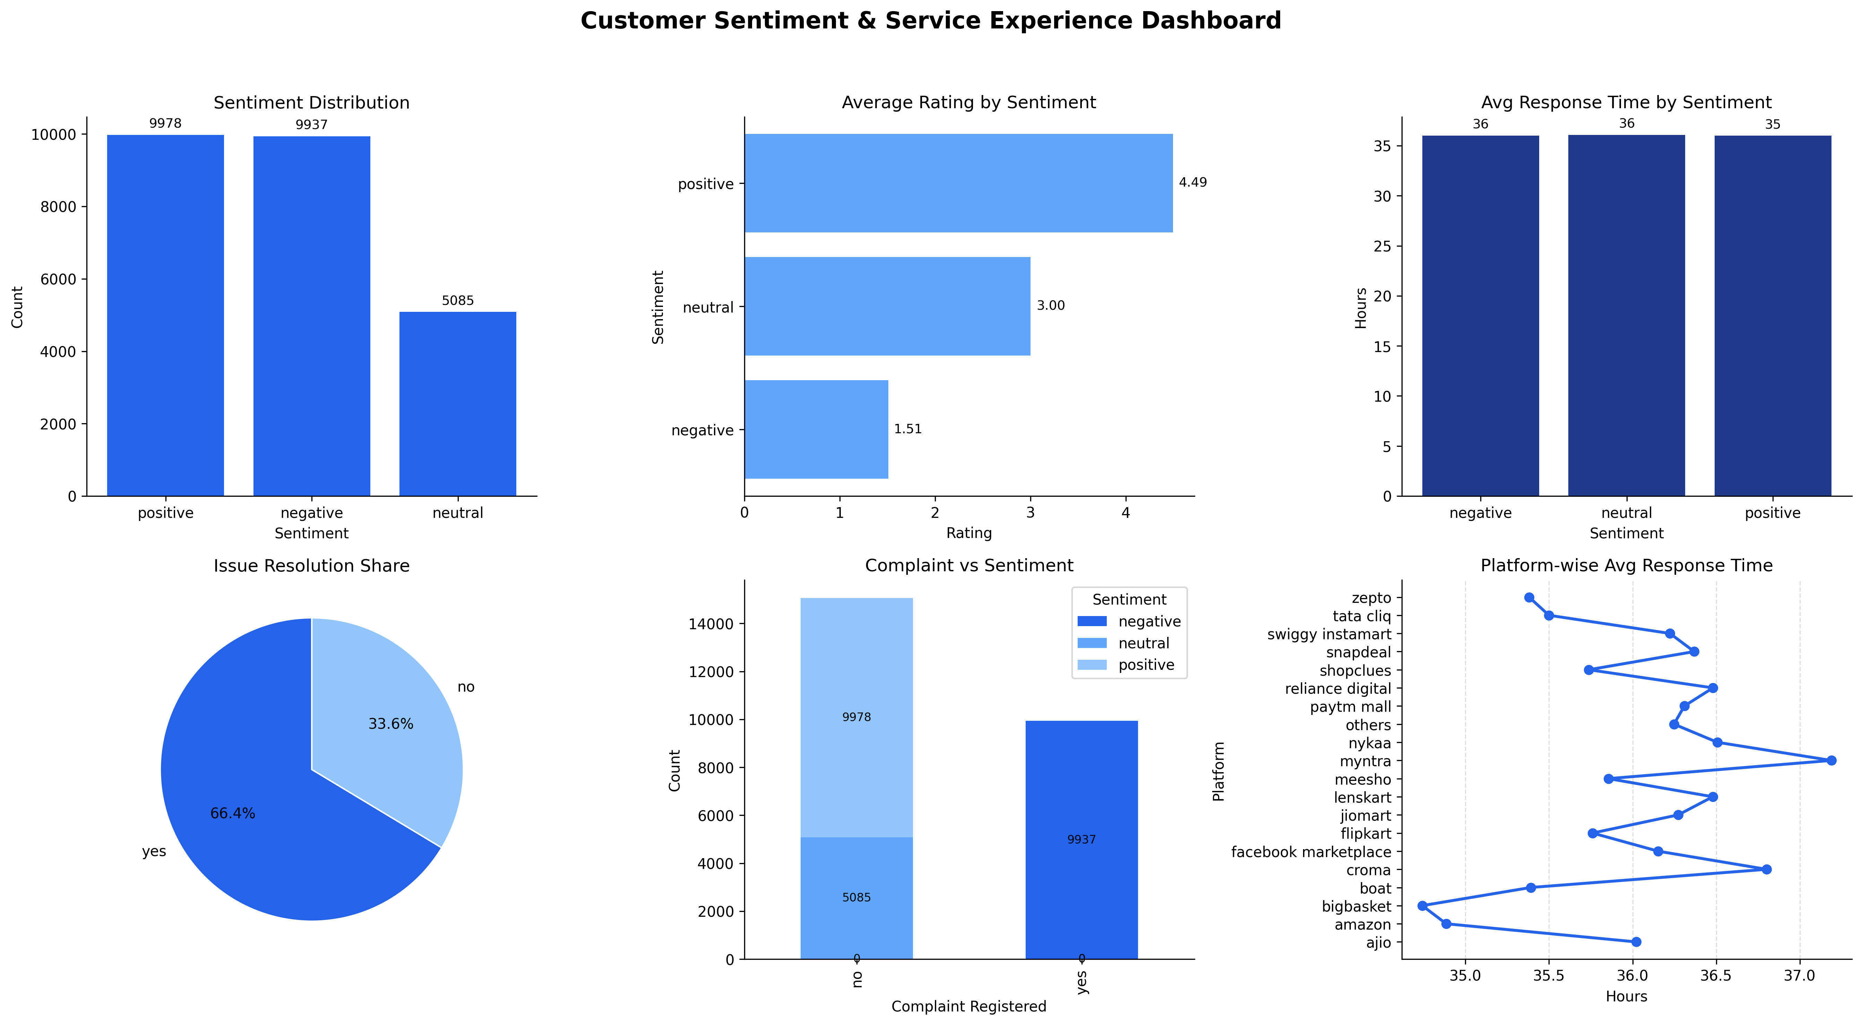

Slide 18
Key Insights and Recommendations
🔍 Key Insights
1. Customers with positive sentiment generally provide higher ratings and experience faster response times.
2. Negative sentiment is strongly associated with delayed response times and unresolved issues.
3. A noticeable portion of customers show rating–sentiment misalignment, indicating hidden dissatisfaction or emotional bias.
4. A significant percentage of negatively sentimented customers did not register complaints, highlighting silent dissatisfaction.
5. Certain platforms and product categories experience higher response times along with higher negative sentiment.
6. Customers whose issues were not resolved show a much higher probability of negative sentiment.
7. The service risk score is highest for negative sentiment customers, validating the effectiveness of the risk model.
8. Younger and older age groups respond differently to service delays, indicating age-based sensitivity.
9. Complaint registration increases sharply as sentiment shifts from neutral to negative.
10. Dashboard visualizations clearly demonstrate that response time, complaints, and issue resolution are tightly interconnected with customer sentiment.

Slide 19
✅ Recommendations
1. Reduce response time, especially beyond critical thresholds (3–6 hours).
2. Prioritize fast issue resolution to prevent escalation into negative sentiment.
3. Actively monitor silent dissatisfied customers using sentiment signals, not just complaint data.
4. Use the service risk score to flag high-risk cases for proactive intervention.
5. Improve service quality on high-risk platforms and product categories.
6. Implement sentiment-aware customer support routing for better handling of critical cases.
7. Use dashboards regularly to track sentiment trends and identify operational bottlenecks.
8. Conduct periodic reviews of rating–sentiment misalignment to uncover hidden service gaps.

Slide 20
THANK YOU

